Slide 1
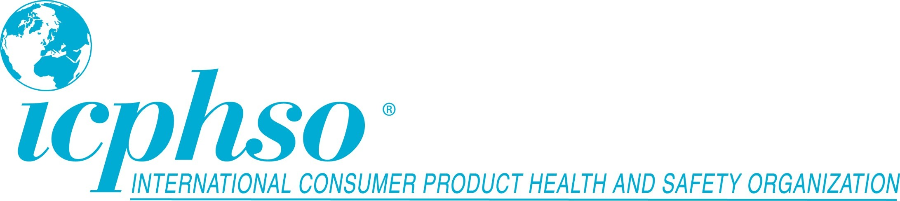

Organization
Best Practices for Managing Third Party Risks
Rick Rosati – Bureau Veritas – Moderator
Ann Minzner Conley – Chubb Ltd
Roberta Telles – IFIA
Don Mays - Samsung
February 23, 2018

Slide 2
Case Study
CostMart is the country’s third-largest retailer of hardware and housewares. They currently source power tools in two different ways. First, they source directly from large power tool manufacturers with both domestic and foreign operations. Second, they use agents in China to source power tools for their own private label products.

Slide 3
Scenario 1
For products sourced domestically from major manufacturers, CostMart’s merchandising team simply places orders and ensures that the products are delivered to their distribution centers on time and in the right quantities. No testing or QA is conducted on these shipments before they are sent to their retail stores.

Slide 4
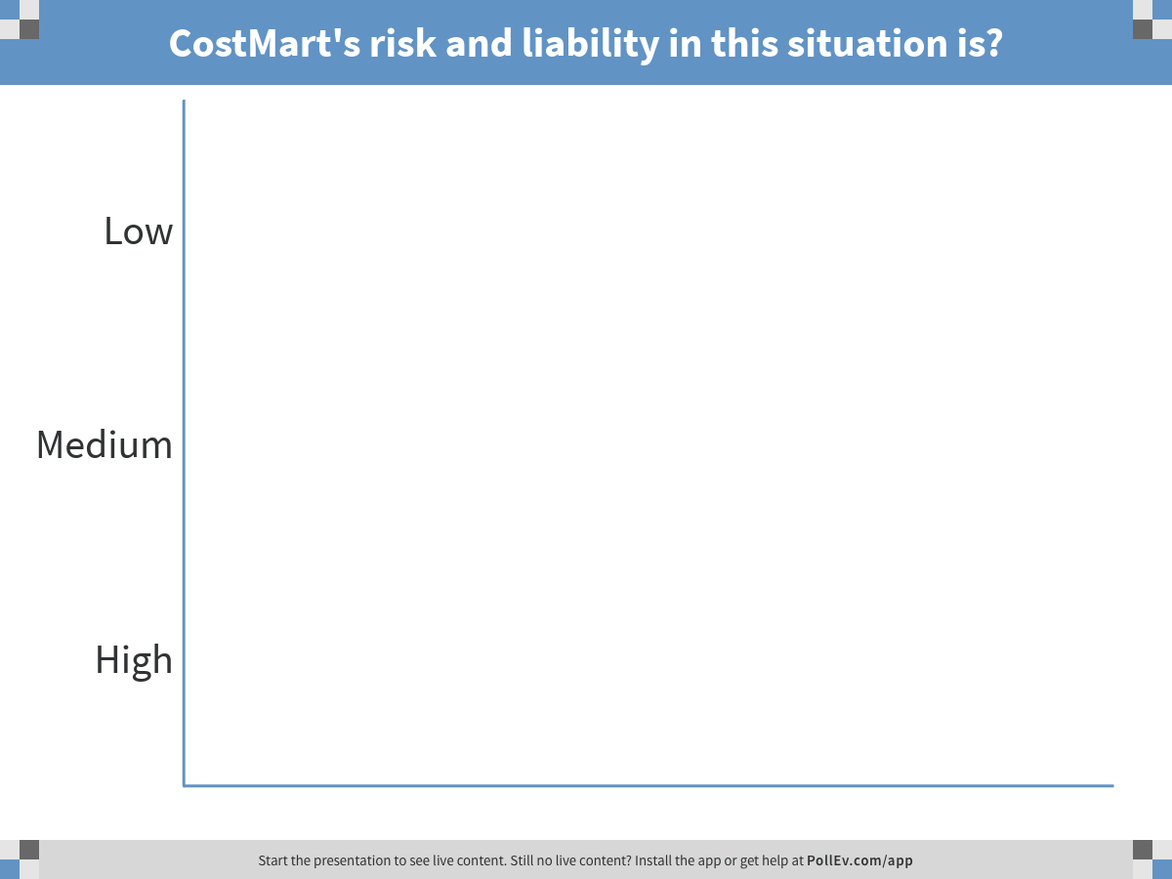
Notes:
Poll Title: CostMart's risk and liability in this situation is?
https://www.polleverywhere.com/multiple_choice_polls/zG5aEmQYWQC9wTJ

Slide 5

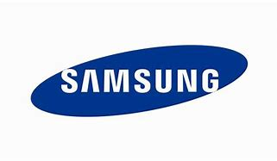
Domestic Sourcing Risks
  Generally considered low risk, however:
  New business partners may not have robust safety and quality assurance programs in place
  There is weak visibility into supply chain
  Certificates of Compliance may still be needed
  Safety issues may present themselves in store
  Need to monitor returns, complaints, warranty claims
  CostMart still has responsibility for reporting safety issues.

Slide 6

Background: TIC sector
Safety Quality Performance Sustainability
Inspection
Certification
Auditing
Testing
Advisory / Training
Gain global market access
Mitigate risks
Help ensure compliance
Improve performance
Reduce in-house compliance costs
Protect reputation
Design
Sourcing
Production
Logistics
Warehouse
Retail
Post retail
Notes:
Service partners to industry and governments:
Gain global market access
Help ensure compliance early in the supply chain starting at the design stage
Improve performance of products and of the supply chain
Reduce in house costs due to TIC scale and expertise

Slide 7
Scenario 1-3: Risk Assessment
  Do products have high risk of fire/injury?
  What is the manufacturers’ track record?
  How is manufacturer demonstrating compliance?
  Is this a globally recognized brand (or factory brand)?
  How complex are the supply chains?
  Is product exclusive to Costmart?
  Is high levels of promotion / distribution expected?
Due diligence required to mitigate risks
Notes:
Conformity assessment: NOT one size fits all – different tools for different needs
Risk assessment needed to determine appropriate CA to mitigate risks
Manufacturer’s track record (product and social compliance):
Factory audits or Historical data of factory/foreign manufactures lawsuits, insurance claims, how well established is factory

Slide 8
Scenario 1: Best Practices
Issues:
Not conducting any due-diligence to verify compliance across supply chain
Recommended practices:
  Conduct desk audit
  Ask for test reports, certificates of compliance
    Ensure testing lab is fully accredited and capable
    Check for counterfeits of certification marks
  If high risk, may require auditing of manufacturers facilities or other conformity assessment
Notes:
Products sourced domestically from major manufacturers, CostMart’s merchandising team simply places orders and ensures that the products are delivered to their distribution centers on time and in the right quantities. No testing or QA is conducted on these shipments before they are sent to their retail stores.
Not verifying compliance with safety standards and regulations: risks of liability, recalls, reputation demage

Slide 9
Scenario 1: best practices
Design
Sourcing
Production
Logistics
Warehouse
Retail
Post retail
Design and Regulatory Review
Specification Development
Regulations & Standards Management
Training
Comparison
Testing
Supplier
Scorecard
Training
Testing
QC Inspection
Audit
Loading/ unloading Checks
In-Warehouse Testing
Mold Prevention Audit
In-Store Testing
Network Conformity Assessment
Failure Analysis
Consumer Panel Evaluation
Product Certification
Smart Products Interoperability

Slide 10
Scenario #1: Liability Risk Management Considerations
Foreign v Domestic Suppliers
  Foreign Jurisdictional Issues
  Risk Transfer Considerations
  QA of Domestic Sourced Products
Merchandising and Risk Management
  Consider Quality and Product Integrity Protocols
Brand Name v Private Label
  Case Law Examples

Slide 11
Scenario 2
For foreign made products sourced from the same major manufacturers, CostMart has set up their own QA inspection team at each distribution center where the shipments are received. Each shipment is accompanied by a Certificate of Compliance indicating that the tools meet both regulatory requirements as well as industry standards. The QA team checks for damaged shipments.

Slide 12
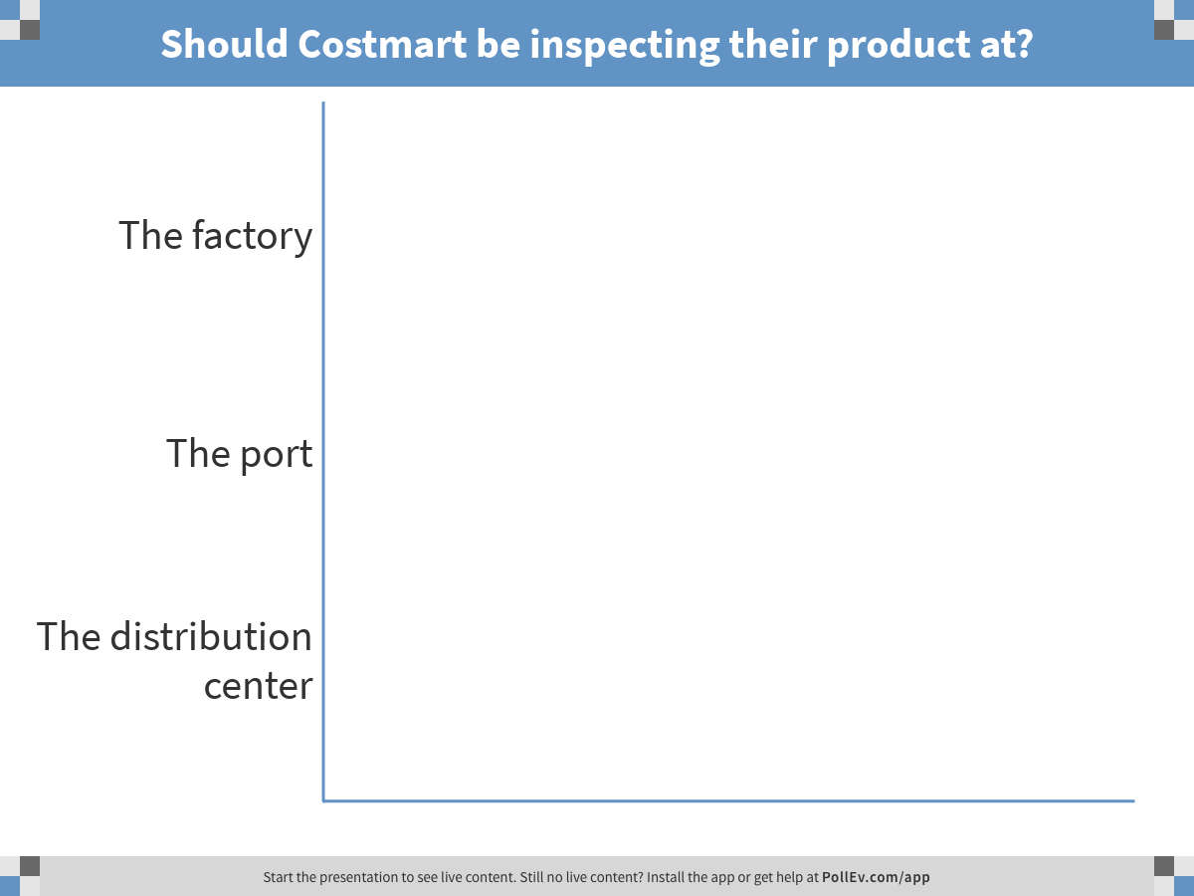
Notes:
Poll Title: Should Costmart be inspecting their product at?
https://www.polleverywhere.com/multiple_choice_polls/VgJPorWfa2zV3zc

Slide 13
Foreign Sourcing Risks
  Generally considered medium risk, however:
  QA inspections should be done at factory in country of origin
  Quality Management Systems and Certificates of Compliance do not provide safety assurance
  Testing is still critical
  Regular factory audits are important to uncover hidden risks
  Supplier scorecards are necessary to “incentivize” good performance – should drive testing and inspection frequency
  CostMart still has responsibility for reporting safety issues.

Slide 14
Scenario 2: best practices
Issues:
Inspections and doc review at distribution center after product is received
Recommended practices:
  Conduct desk audit, review docs before products are shipped
  Conduct inspections earlier in the chain (at country of origin)
  Use third-party to supplement / validate internal inspections
  Provide training to CostMart inspectors
  Due-diligence to ensure integrity of testing and certification
Notes:
For foreign made products sourced from the same major manufacturers, CostMart has set up their own QA inspection team at each distribution center where the shipments are received. Each shipment is accompanied by a certificate of compliance indicating that the tools meet both regulatory requirements as well as industry standards. The QA team checks for damaged shipments as well as for the presence of mold.
Current practice: internal QA team inspect shipments received + certificates of compliance
Conduct desk audit: Ask for test reports, third-party certifications / Check for counterfeits of certification marks
Training of Costmart inspectors: IFIA members train internal teams to ensure they know what to look for,
If high risk, conduct inspections earlier in the chain (overseas at loading)

Slide 15
Scenario 2: best practices
Design
Sourcing
Production
Logistics
Warehouse
Retail
Post retail
Design and Regulatory Review
Specification Development
Regulations & Standards Management
Training
Comparison
Testing
Supplier
Scorecard
Training
Testing
QC Inspection
Audit
Loading/ unloading Checks
In-Warehouse Testing
Mold Prevention Audit
In-Store Testing
Network Conformity Assessment
Failure Analysis
Consumer Panel Evaluation
Product Certification
Smart Products Interoperability

Slide 16
Scenario #2: Liability Risk Management Considerations
Quality Oversight
  Certificates of Compliance and Company Practices
  Documentation of Response Protocols and Records Retention
    Food processor claim example
  In House v External QA Resources and Responsibilities
  Co-Investment with foreign suppliers
Vendors Coverage Considerations

Slide 17
Scenario 3
For their private label products, CostMart makes sure that the agent they use for sourcing products from various factories has contracted with an independent laboratory who tests a prototype of the power tools to make sure they meet regulations as well as CostMart’s own internal standards. The agents sends all documentation to CostMart’s headquarters prior to shipping. Again, CostMart’s domestic QA teams inspect the products upon delivery to the distribution centers.

Slide 18
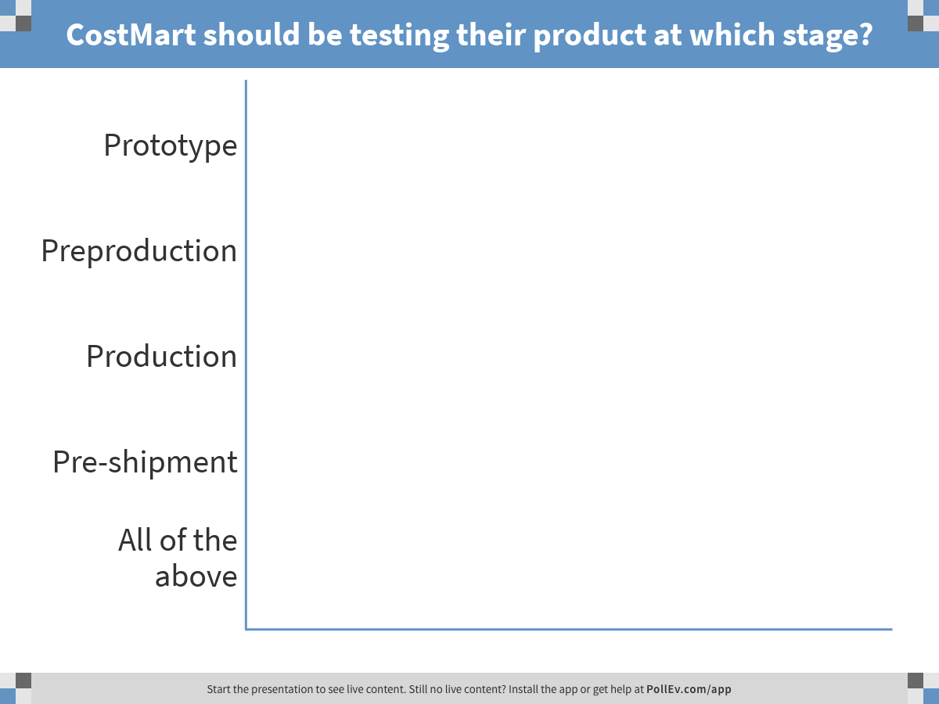
Notes:
Poll Title: CostMart should be testing their product at which stage?
https://www.polleverywhere.com/multiple_choice_polls/rbXUVIPyxEP0Rwz

Slide 19
Agents, Labs, and Other Risks
  Generally considered high risk.
  Loss of supply chain visibility
  Agents may not work for CostMart’s best interests
  Accurate testing is critical.

Slide 20
Testing Risks
  Lab not accredited to perform needed tests
  Equipment not calibrated
  Wrong test method used
  Personnel not trained or qualified
  Inaccurate test results
  Non-representative (“golden”) samples
  Test data not secure
  Falsified test data – a growing concern

Slide 21
Scenario 3: best practices
Issues:
Not ensuring supply chain has the know-how and capabilities
Recommended practices:
  Contract comparison testing and building of supplier scorecard
  Review product design to identify potential risks/concerns
  Train supply chain on requirements
  Require certifications: social audits, management systems, safety
  Capabilities audits to assess knowledge, expertise
  In-store testing
Notes:
For their private label products, CostMart makes sure that the agent they use for sourcing products from various factories has contracted with an independent laboratory who tests a prototype of the power tools to make sure they meet regulations as well as CostMart’s own internal standards. The agents sends all documentation to CostMart’s headquarters prior to shipping. Again, CostMart’s domestic QA teams inspect the products upon delivery to the distribution centers.
Current practice: Third-party testing + inspections upon delivery
Issues:
Recommended practices:
Agents can use TIC for comparison testing to evaluate which supplier provides best product
Training supply chain (on requirements)
Review design and identify concerns
Private label, look for social audits, ISO 19000 cert, capability audits (assessment knowledge, expertise etc),
Since private label, in store testing and other conf assessment to investigate issues

Slide 22
Scenario 3: best practices
Design
Sourcing
Production
Logistics
Warehouse
Retail
Post retail
Design and Regulatory Review
Specification Development
Regulations & Standards Management
Training
Comparison
Testing
Supplier
Scorecard
Training
Testing
QC Inspection
Audit
Loading/ unloading Checks
In-Warehouse Testing
Mold Prevention Audit
In-Store Testing
Failure Analysis
Consumer Panel Evaluation
Product Certification
Smart Products Interoperability
Notes:
As retailers liability increase, as in scenario 3 with private label, there is an expanded role for third-party CA to help mitigate risks
Reinforce: TIC members provide a wide range of services that goes way beyond testing
One set of services don’t fit all situations: it always case by case, depending on situation, risk factors
Any these CA services can be used to increase retailers / importers confidence of compliance to mitigate risks of liability and reputation demage that comes from placing unsafe products on the market

Slide 23
Scenario #3: Liability Risk Management Considerations
Engagement of independent laboratories
  Proto-type testing
    Risk Management Considerations
      Specifications
      Qualified / Accredited
      Life Cycle Analysis
      Insurance Requirements
  Testing for regulatory and internal standards compliance
    Documentation and Retention
Documentation reviewed prior to shipping
  Cosmetic jewelry manufacturer risk management example
Internal QA Testing
Notes:
Independent laboratories:
-- Own the specifications process; ensure the lab is qualified / accredited to meet expectations;
-- Prototype testing – Consider lifecycle analysis, including environmental; Ensure standards are appropriate for product, especially with anticipated changes in usage / user profiles
-- Consider regulatory requirements to be a minimum

Slide 24
Chubb is the marketing name used to refer to subsidiaries of Chubb Limited providing insurance and related services. For a list of these subsidiaries, please visit our website at www.chubb.com. This document is advisory in nature and is offered as a resource to be used together with your professional insurance advisors in maintaining a loss prevention program. No liabilities or warranties are assumed or provided by the information contained in this document.

Slide 25
Scenario 1
CostMart’s risk and liability in this situation is?
Low
Medium
High

Slide 26
Scenario 2
Should CostMart be inspecting their product at?
Factory
Port
Distribution Center

Slide 27
Scenario 3
CostMart should be testing their private label products at which stage?
Prototype
Preproduction
Production
Pre-shipment
All of the above

